Slide 1

Deal Or Not
107753034 蔡政憲
107753022 賴以立

Slide 2
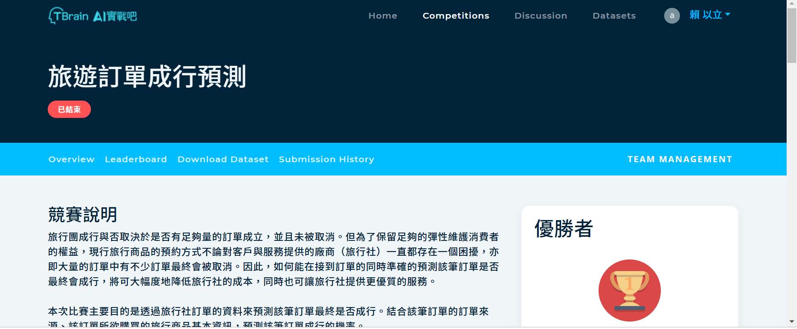
Where is Data

Slide 3
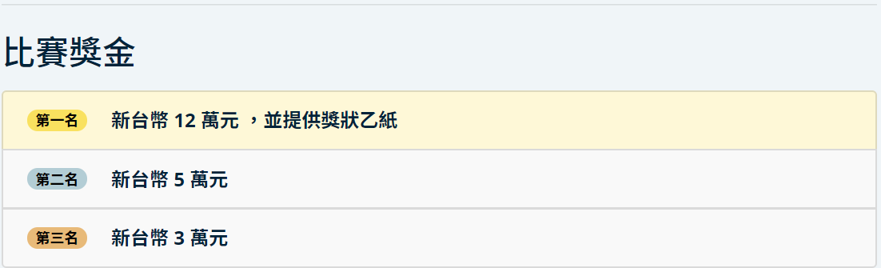
Why

Slide 4
Input format
airline.csv
cache_map.csv
day_schedule.csv
group.csv
order.csv

Slide 5
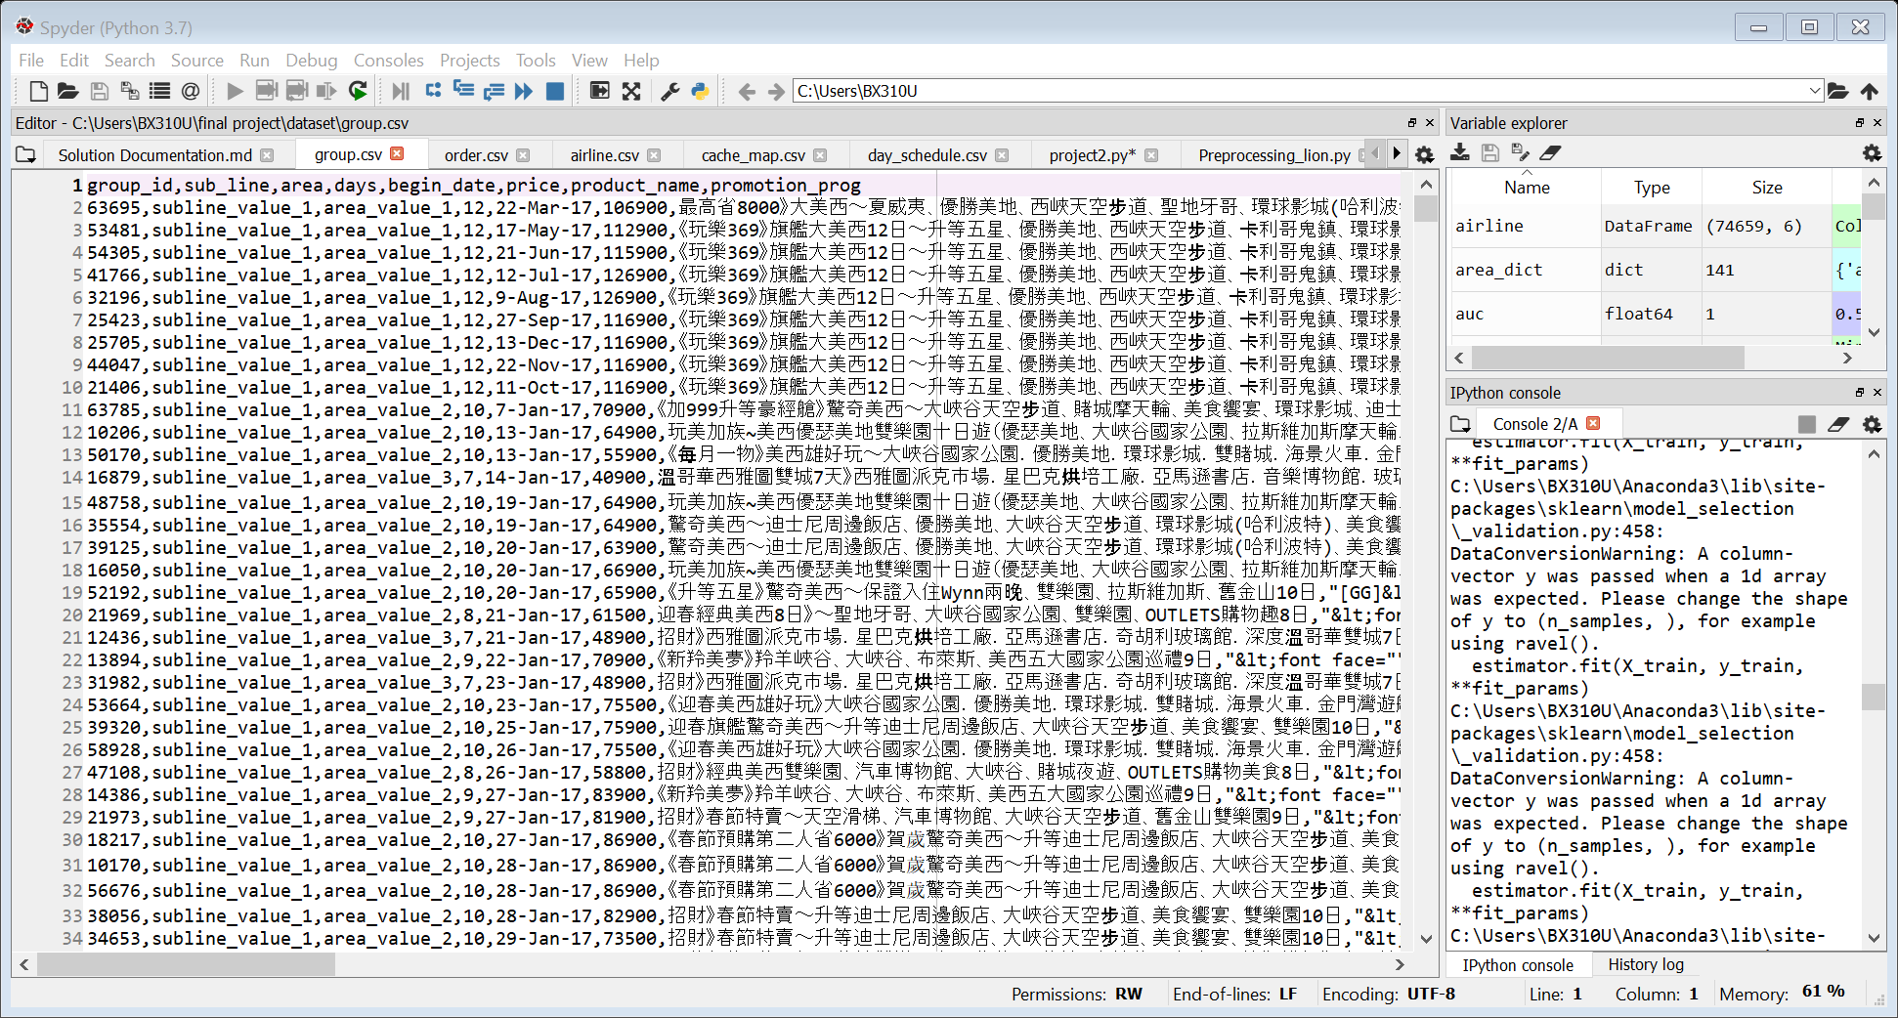
Group.csv

Slide 6
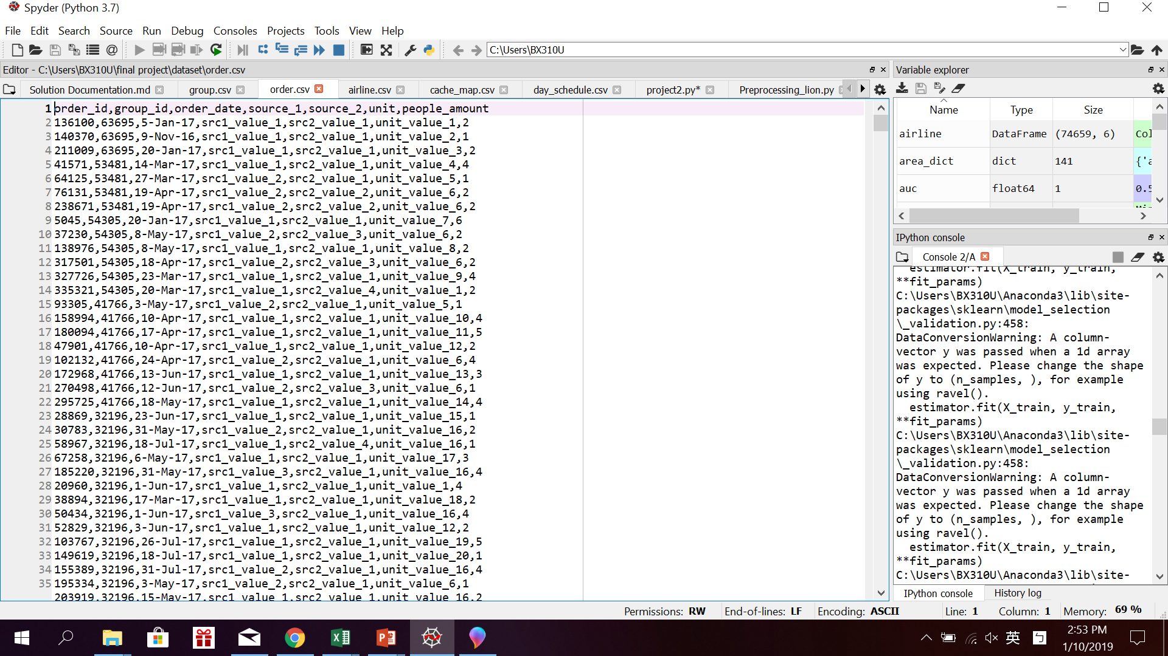
Order.csv

Slide 7
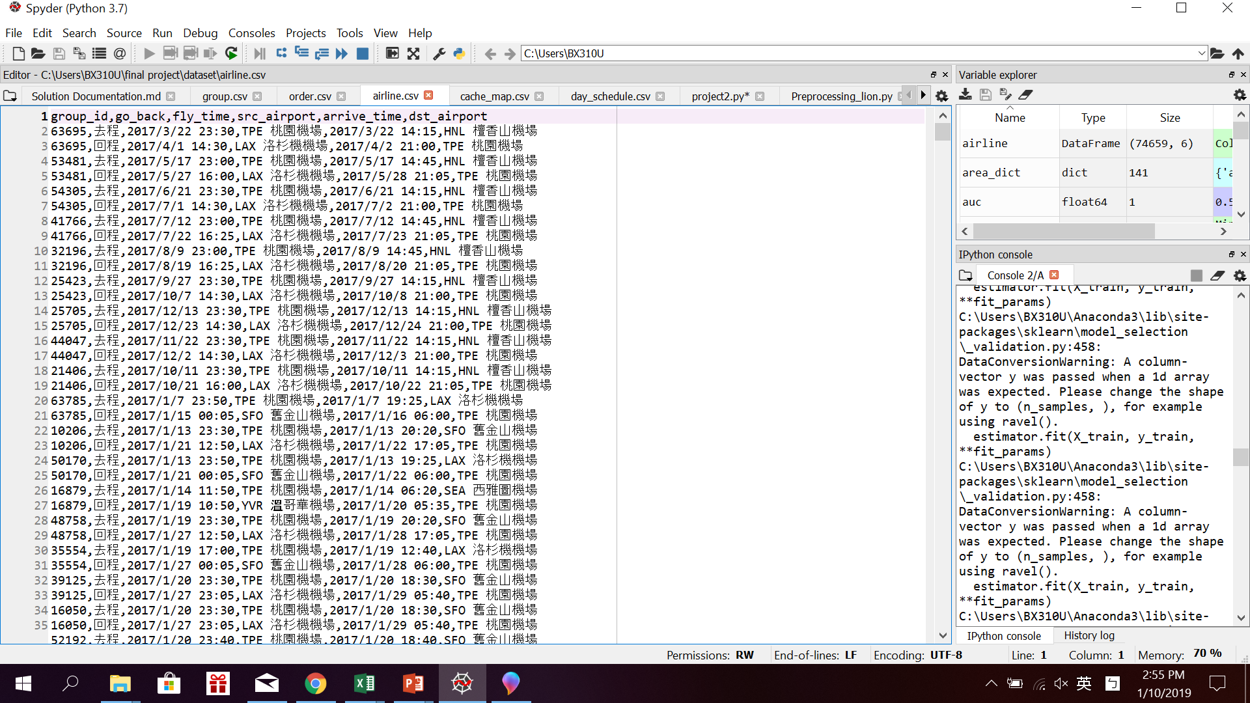
Airline.csv

Slide 8
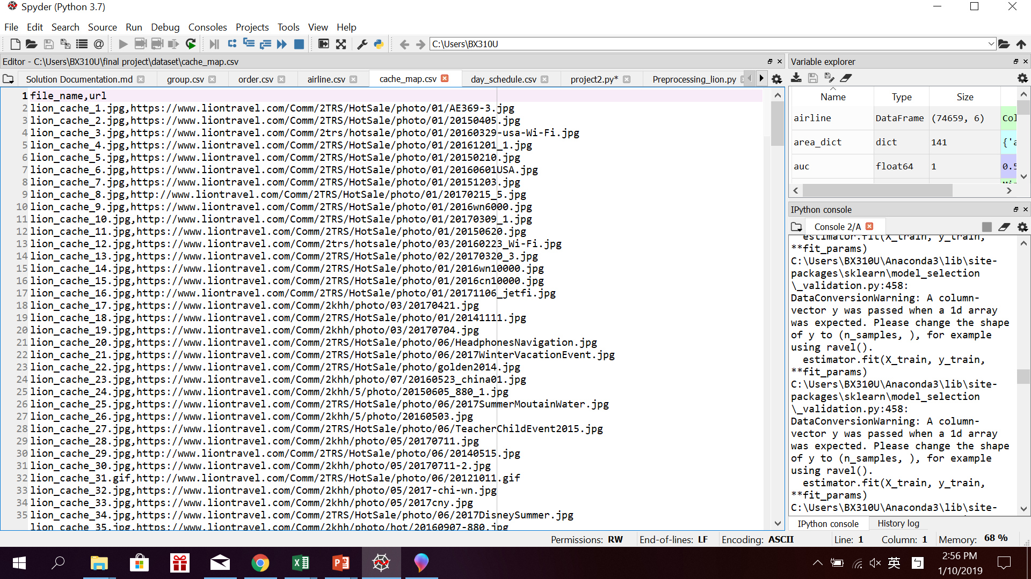
Cashe_map.csv

Slide 9
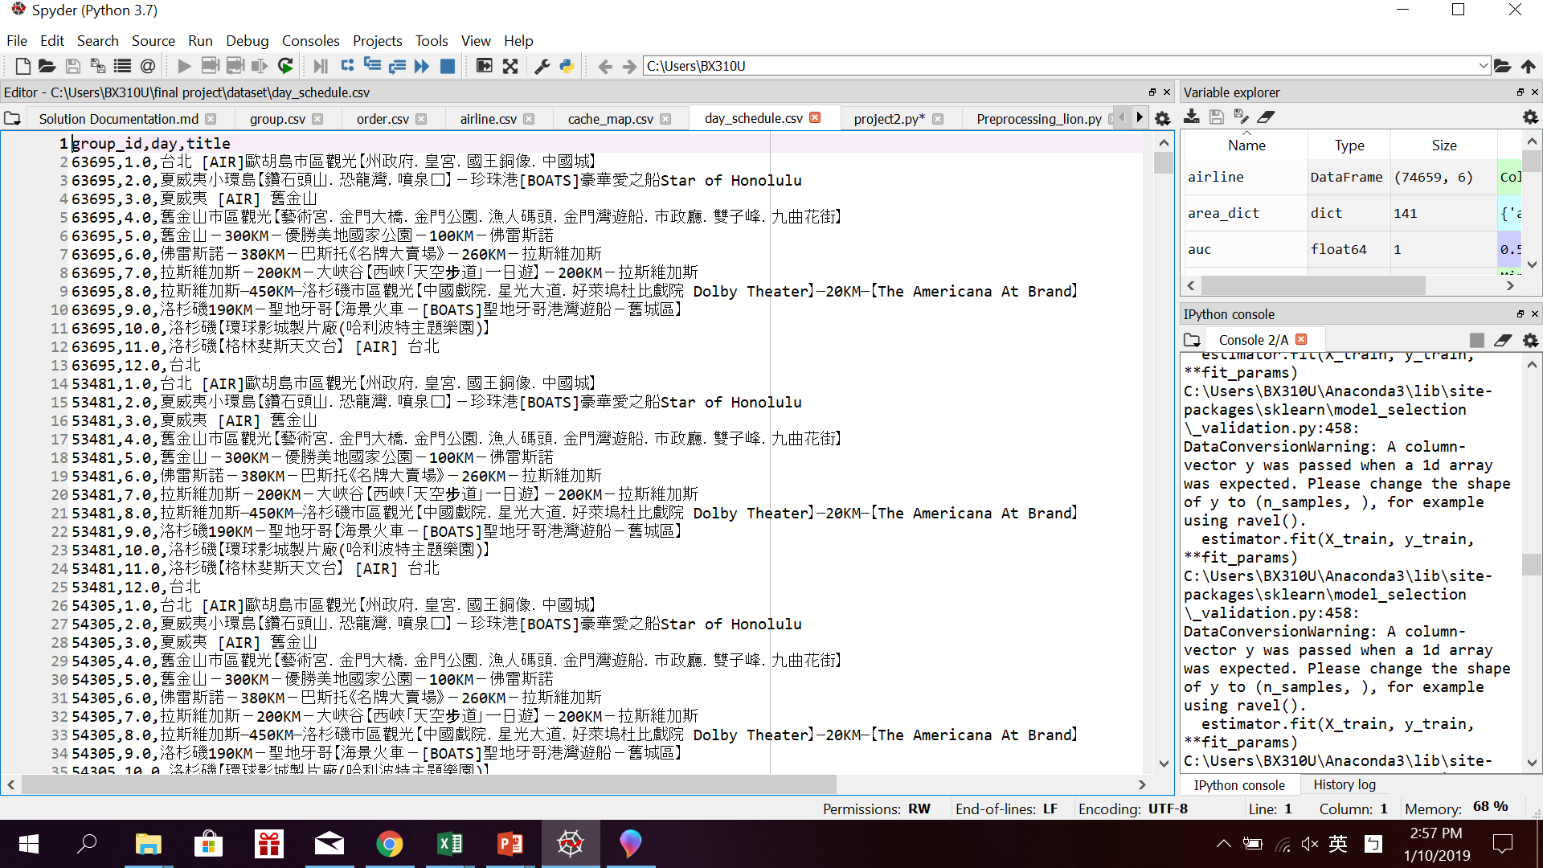
Day_schedule.csv

Slide 10
Input Preprocessing
No Missing Data
What are useful features?
Evaluate
Notes:
將

Slide 11
Travel Motivation
Free time
Have enough money
Convenient transportation options for tourists and modern tourist facilities
Have a social atmosphere that encourages tourism
Source : https://wiki.mbalib.com/zh-tw/%E6%97%85%E6%B8%B8%E5%8A%A8%E6%9C%BA

Slide 12
Feature
How many people?
Days between order and depart?
Return date is holidaty?
Order date? Holiday? Month?
Expensive? Discount? High cp value?
Notes:
將

Slide 13
Feature selection
Order date month
People amount
days
cp
price
Begin date month
discount
Fly count
Order date dayofweek
MORE...
Notes:
將

Slide 14
Null model
How to build a null model: always return the most popular Category
Most of orders would be cancled in the end depend the data set:
A model that labels all order as not deal => get 0.5 AUC

Slide 15
Modeling
Logistic Regression
Random Forest

Slide 16
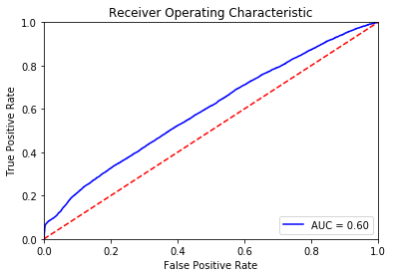
Logistic Regression
Poor AUC : 0.59
Null model : 0.5
Not good enough!
Thought:
There are large number of categorical features/variables.
Transformations for non-linear features do not do well.

Slide 17
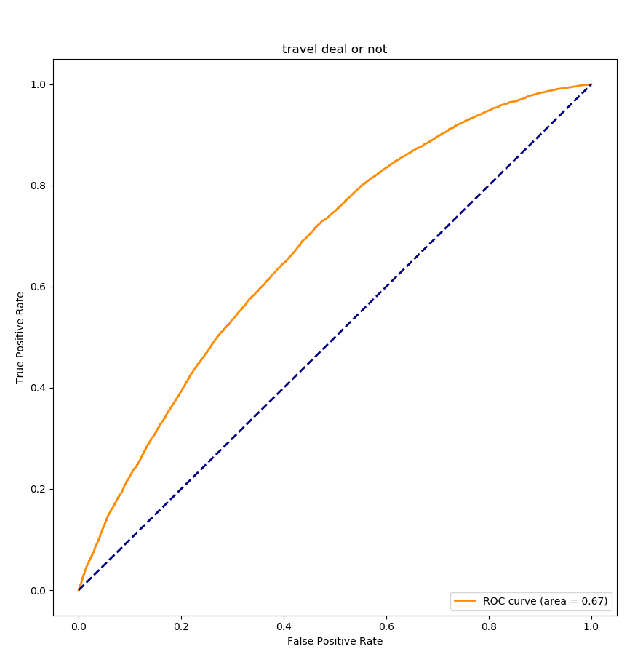
Random Forest
n_estimators = 200
AUC : 0.67
Null model : 0.5
Perform evaluation : Cross-validation

Slide 18

Improvement
In the begining, AUC is around 0.61,
after we put the source to be a feature,
and changed it into dummy variables, AUC was up to 0.67!

Slide 19
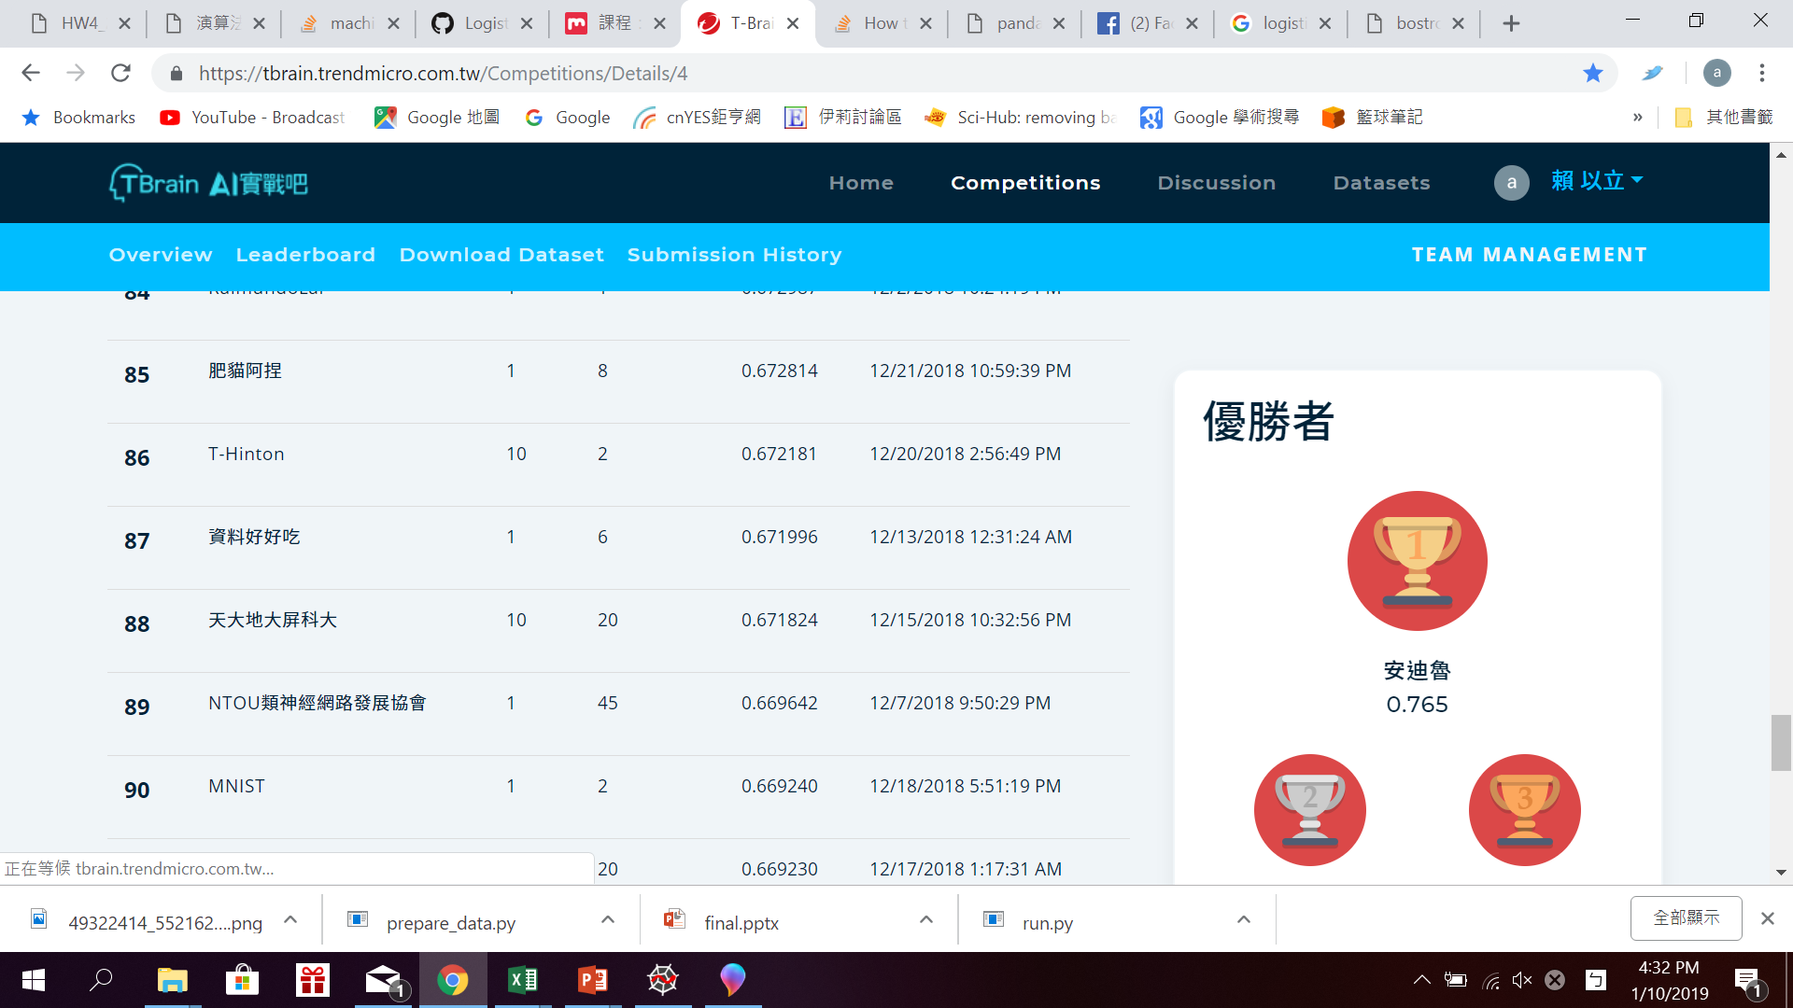
Result
AUC : 0.67 (the competition No1 : 0.76)
Accuracy : 0.7476356509651102

Slide 20


Challenge
What is useful feature?
How to produce? Try!
Model choose
Logistic Regression?
KNN?
Random Forest?
(the No.1 use LGB model)

